Slide 1
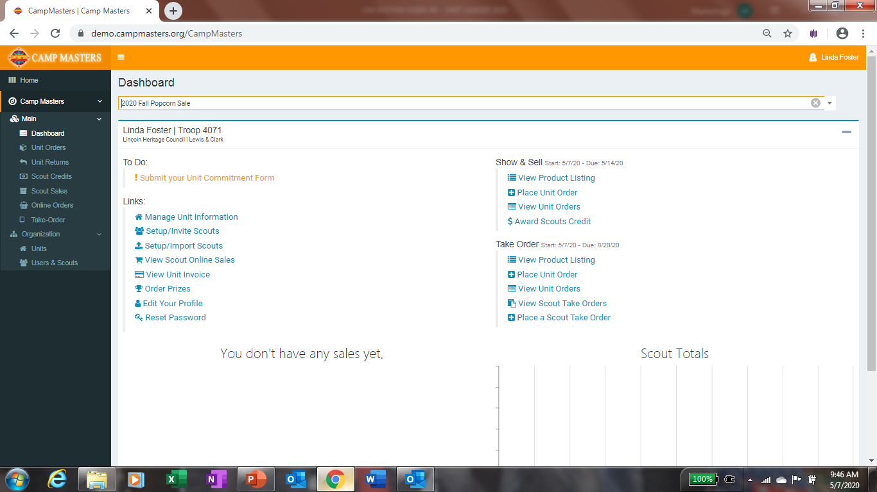
CM SYSTEM GUIDE #4 – UNIT LEADERS
COUNCIL WILL EMAIL TO UNIT LEADER A “SINGLE-SIGN ON LINK. USE THE LINK TO ACCESS THE ORDERING SYSTEM.
OR
ACCESS VIA WWW.CAMPMASTERS.ORG; see bottom left on screen “Council/Units/Scouts Log In Here”. YOUR UNIQUE EMAIL WILL BE YOUR LOG-IN. CLICK ON FORGOT PASSWORD AT BOTTOM OF LOGIN BOX. ENTER YOUR EMAIL ON NEXT SCREEN TO SEND A SET UP PASSWORD LINK TO YOUR EMAIL.
** use Google Chrome or Firefox Web Browser

Slide 2
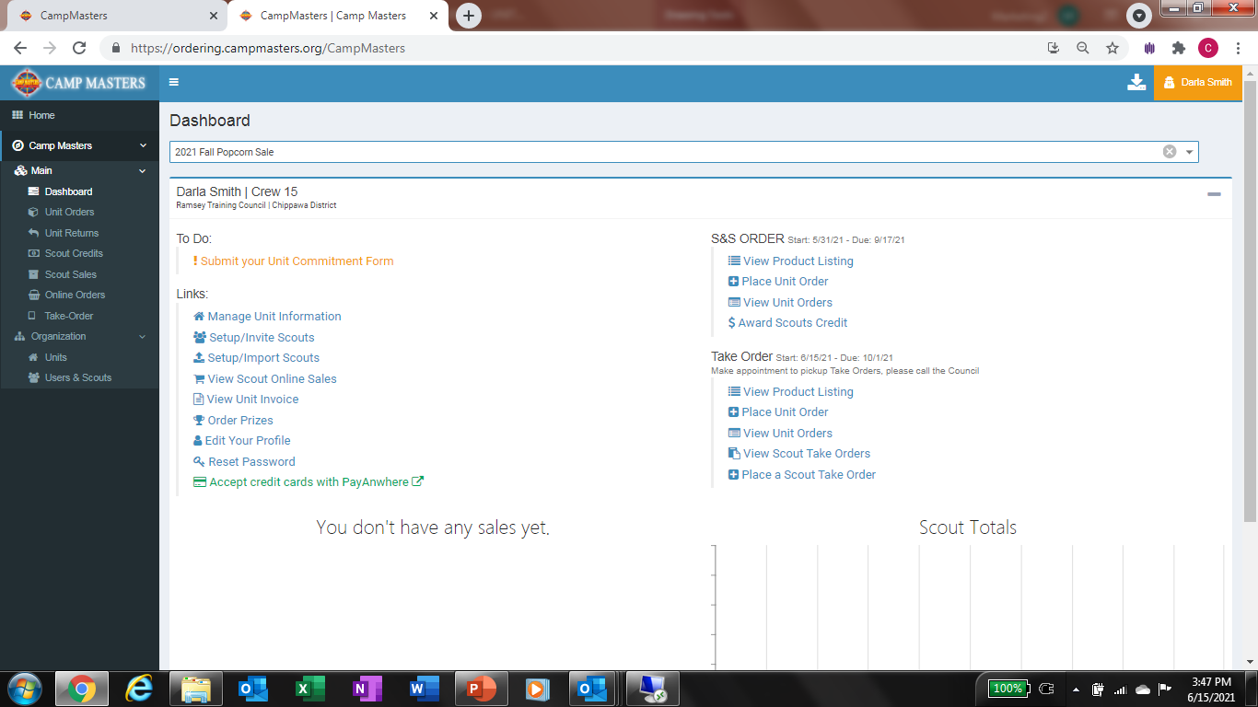
Step 1 - Commit to sale/update contact info
Place Unit S&S Order See pg. 8
Step 2 – Setup Scouts Individually see pg. 8 or Click Setup/Import Scouts to Import all Scouts. See pg. 4–7 for instructions.
Place Unit Take Order See pg.9
Step 3 – Click Setup/Invite Scouts to send sign-on link. See pg. 7. NOTE: Scouts must have a UNIQUE email address to access the system.

Slide 3
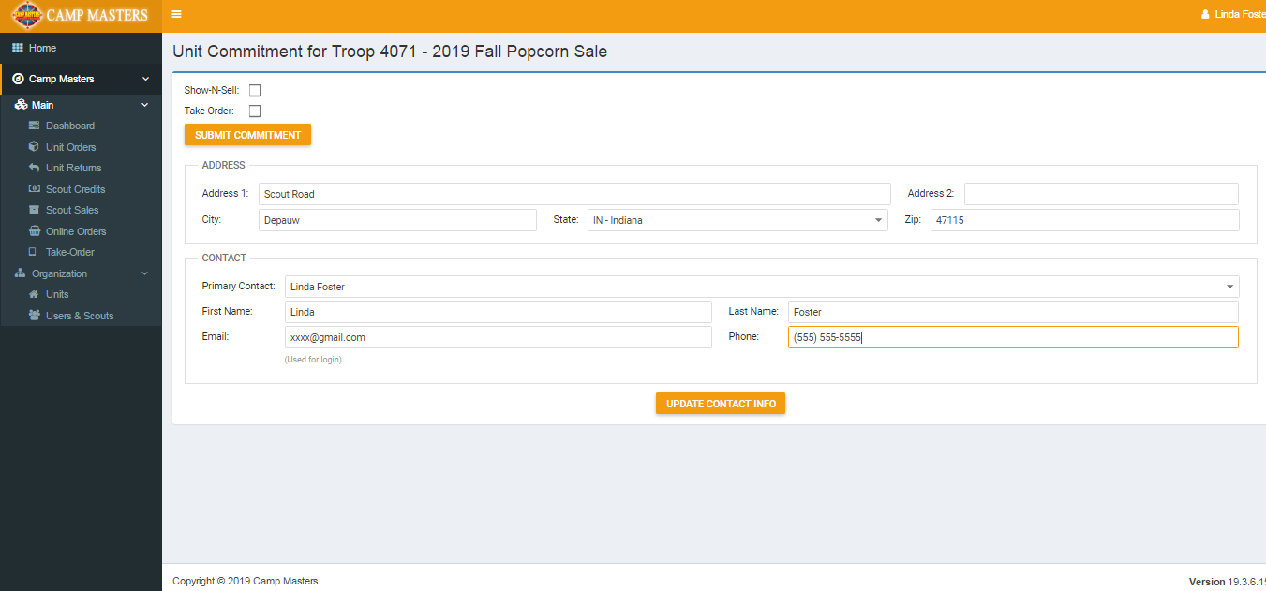
Select Sale Type(s); click “Submit Commitment
Update contact info; click “Update Contact Info” and return to Dashboard.

Slide 4
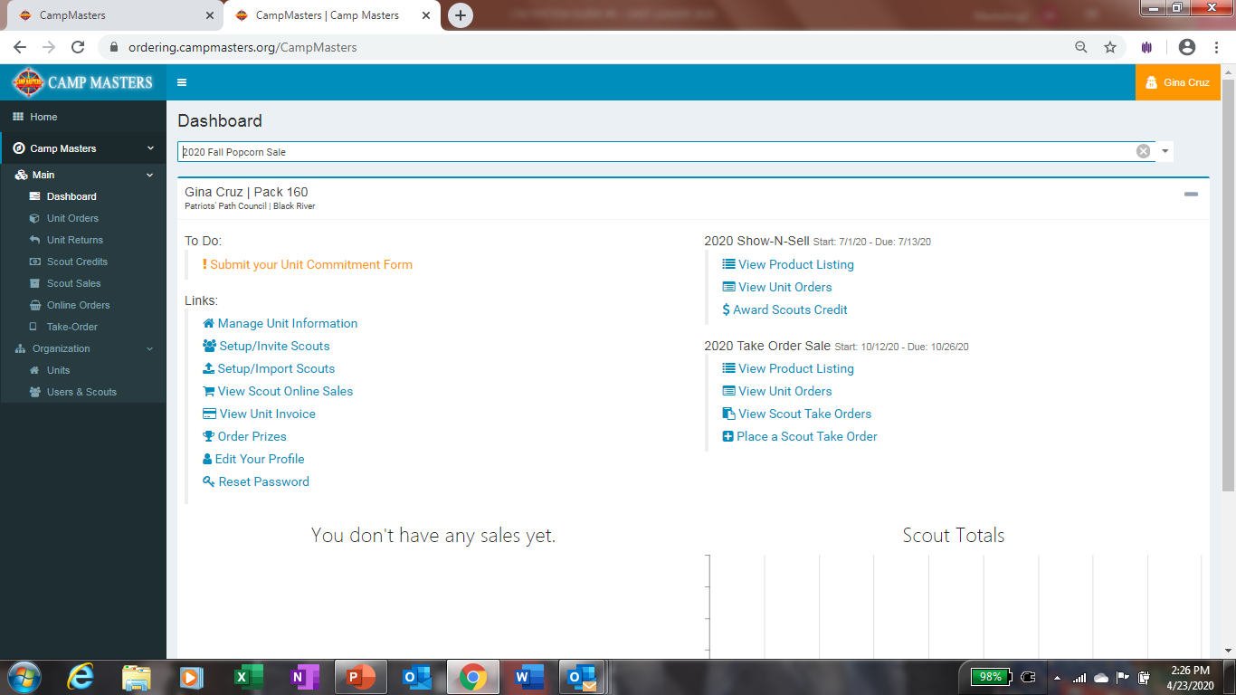
To Import Scouts, click on “Setup/Import Scouts”

Slide 5
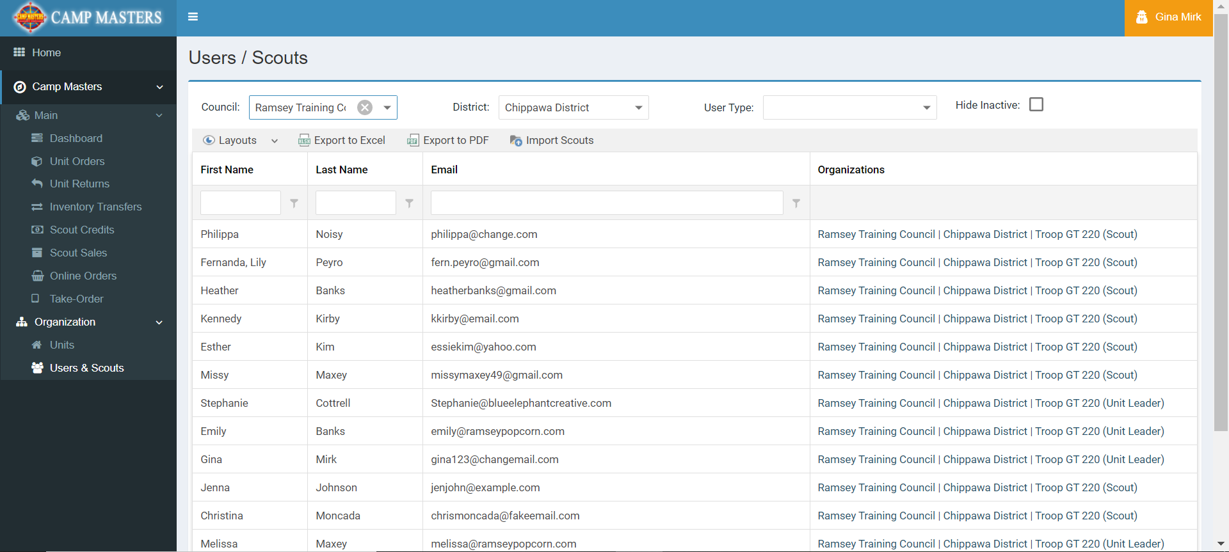
Click on Import Scouts above.
NOTE: Scouts must have a UNIQUE email address to access the system. SCOUTS CANNOT SHARE AN EMAIL WITH A LEADER OR SIBLING UNLESS SIBLING IS IN SAME UNIT AND SET UP UNDER THE SAME ACCOUNT, ENTER MULTIPLE SIBLINGS NAMES IN FIRST NAME COLUMN FOR A SHARED ACCOUNT

Slide 6
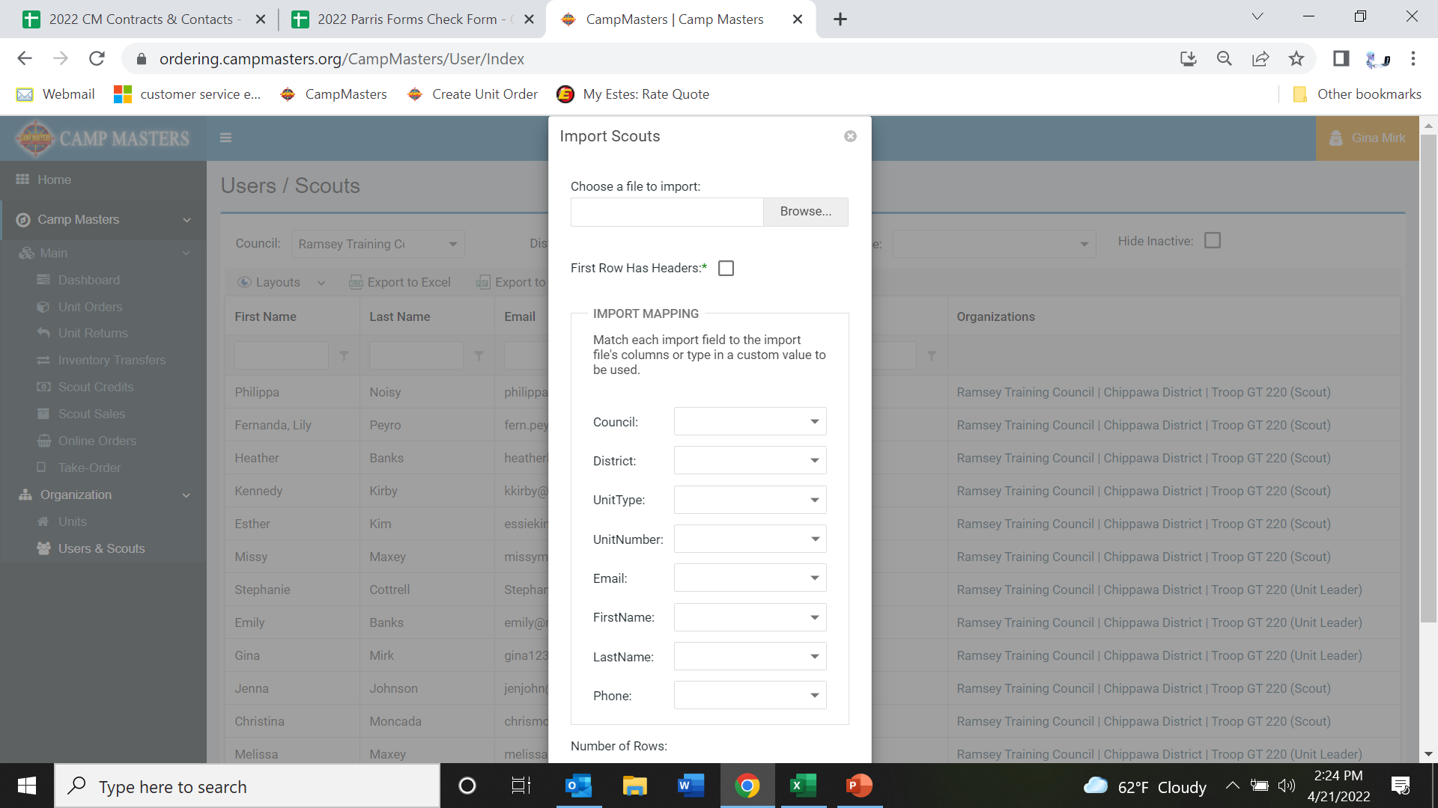
You will need to create an excel spreadsheet with Headers to match the Import template to upload your Scouts. Once your template is completed, click on Browse to select your excel file. Click “First Row Has Headers” on Import Scouts form. Click the down arrow for Council and select your header “Council” it will populate your Council Name. Continue until all information is on the Import Scouts form. This will open up where you can then click “Import”

Slide 7
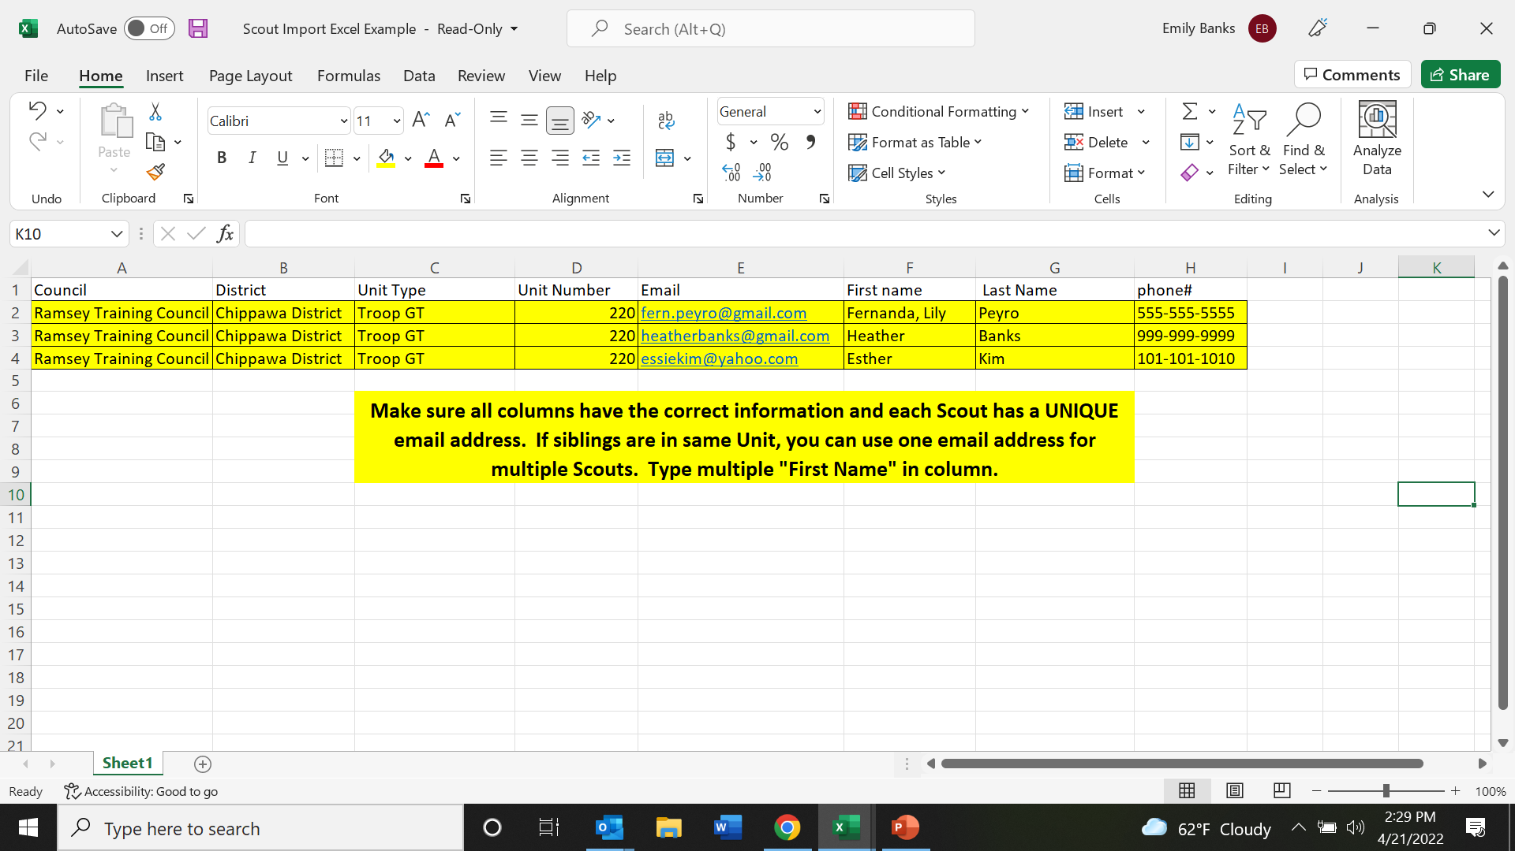

Slide 8
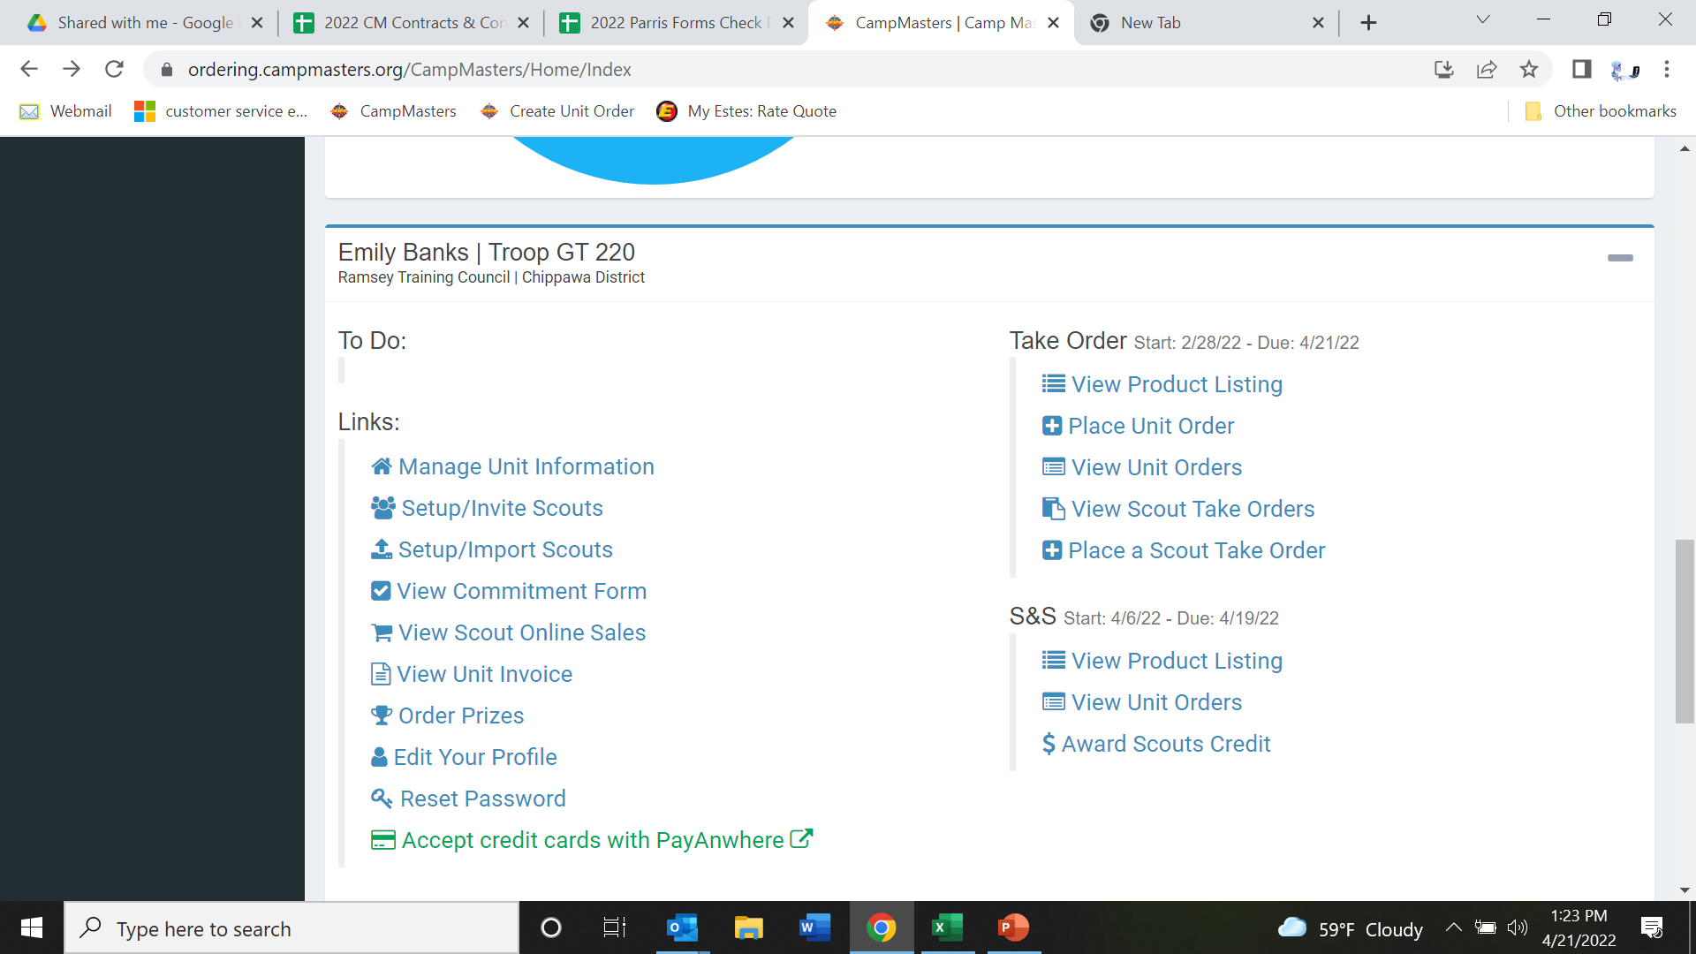
Sending scouts the sign on link/adding or removing a scout from your unit.
Step 1 – Return to your dashboard, under links, “Manage Unit Information”

Slide 9
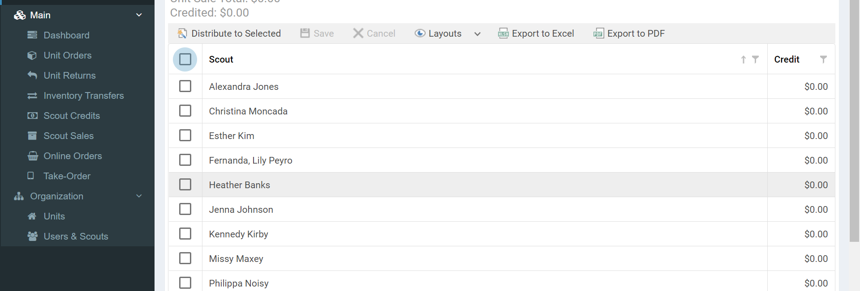
Step 1 – OR select “units” under the Organization tab and select your unit.

Slide 10
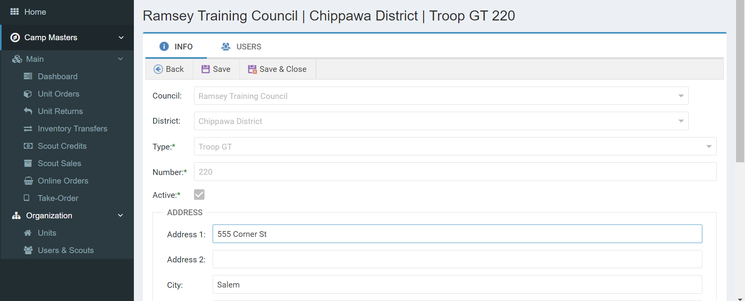
Once selected, click on the tab labelled “USERS”

Slide 11
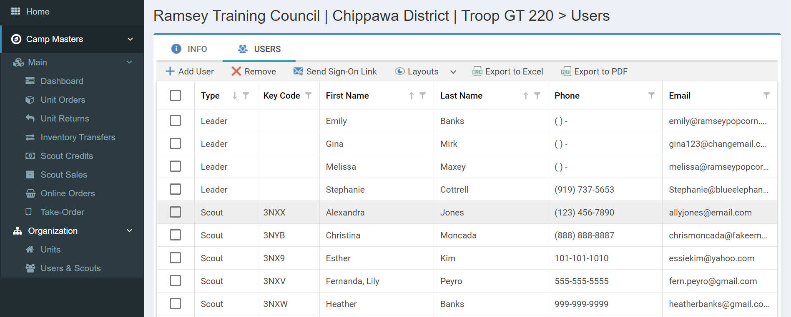
Step 2 – Setup/Invite Scouts – From this page, send Sign-on Link to all Scouts or select Scouts by clicking on box to to the far left of Scouts name to check mark. Once Scouts box is check marked, click on Send Sign-On Link
Step 3 - Click on “+Add User” for new Scouts. Click “Remove” to remove inactive Scouts. Click on any Scout to update information. Do NOT select any permissions for scouts!
EACH SCOUT MUST HAVE A UNIQUE, ACTIVE EMAIL TO ACCESS THE CM SYSTEM. A SCOUT CANNOT SHARE AN EMAIL WITH A LEADER OR A SIBLING UNLESS SIBLINGS ARE SET UP UNDER THE SAME ACCOUNT BY ENTERING MULTIPLE 1ST NAMES IN FIRST NAME COLUMN

Slide 12
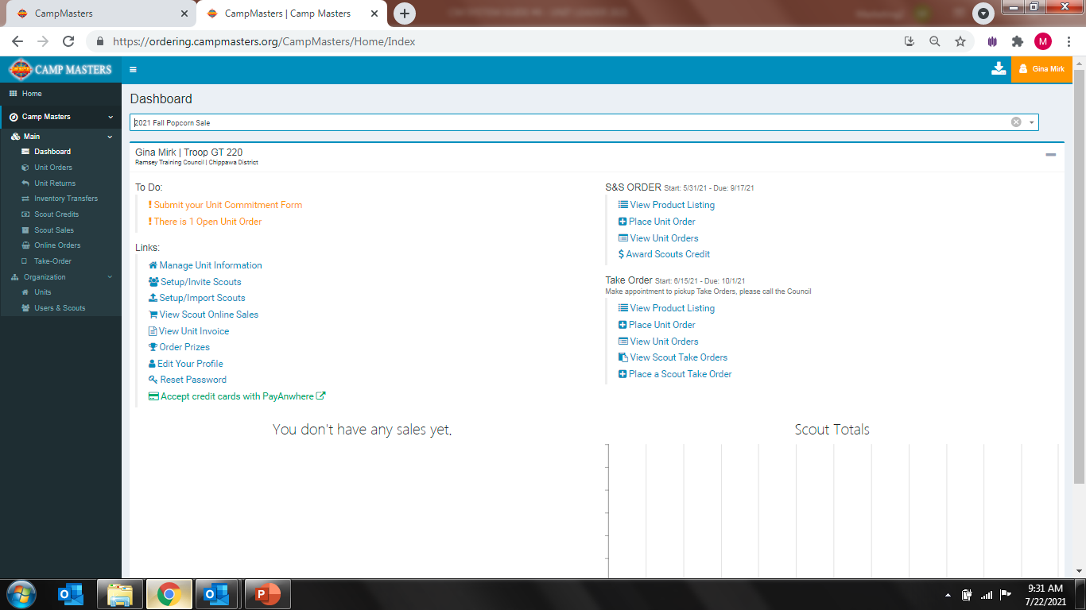
Placing Unit S&S Order. Click on Place Unit Order
2.
Placing Unit Take Order at 1. Scout Level, click on Place a Scout Take Order, see Slide 12
2. Unit Level, click on Place Unit Order, see next slide
1.

Slide 13
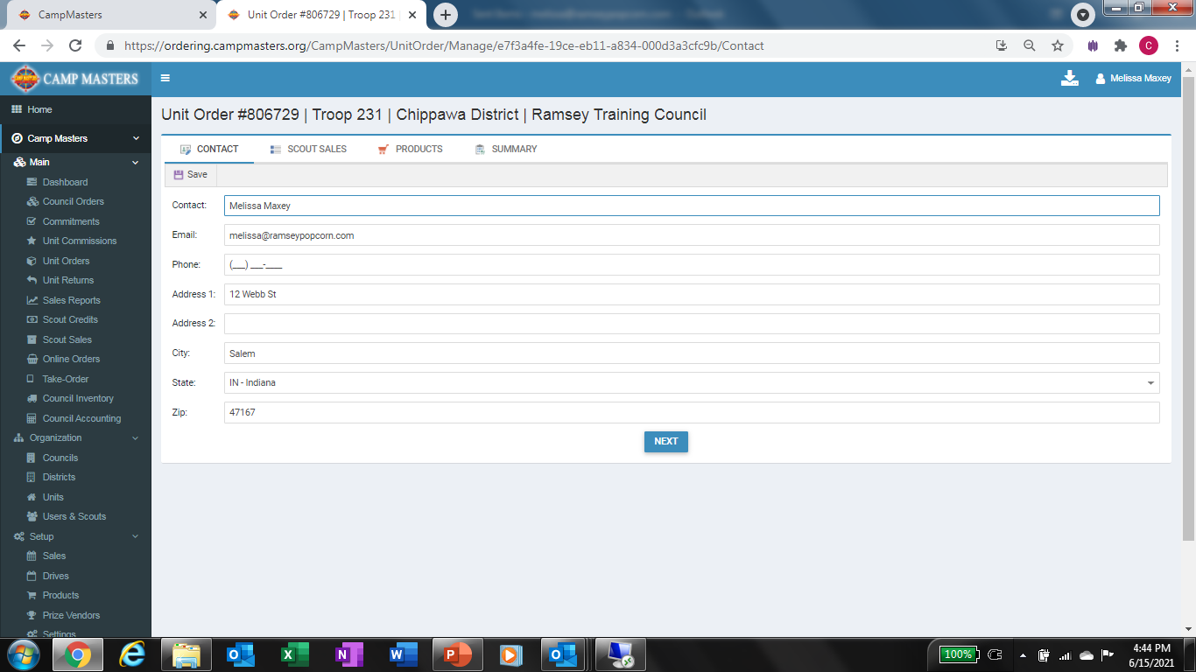
Click Next

Slide 14
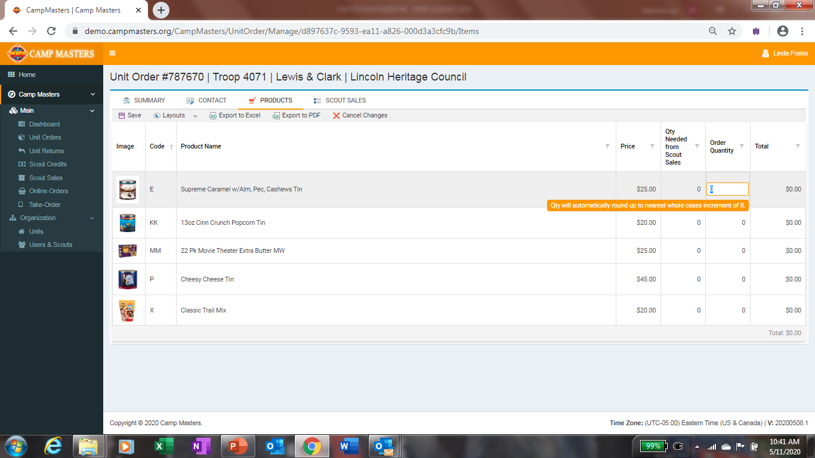
Must be entered in container quantities equal to full cases.
Click Save when finished with order.

Slide 15
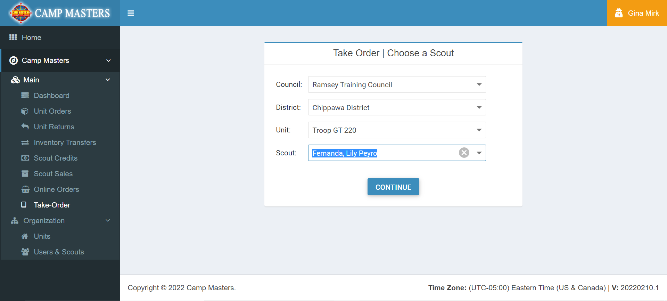
Select your Scout from the Drop down to enter their Take Order.

Slide 16
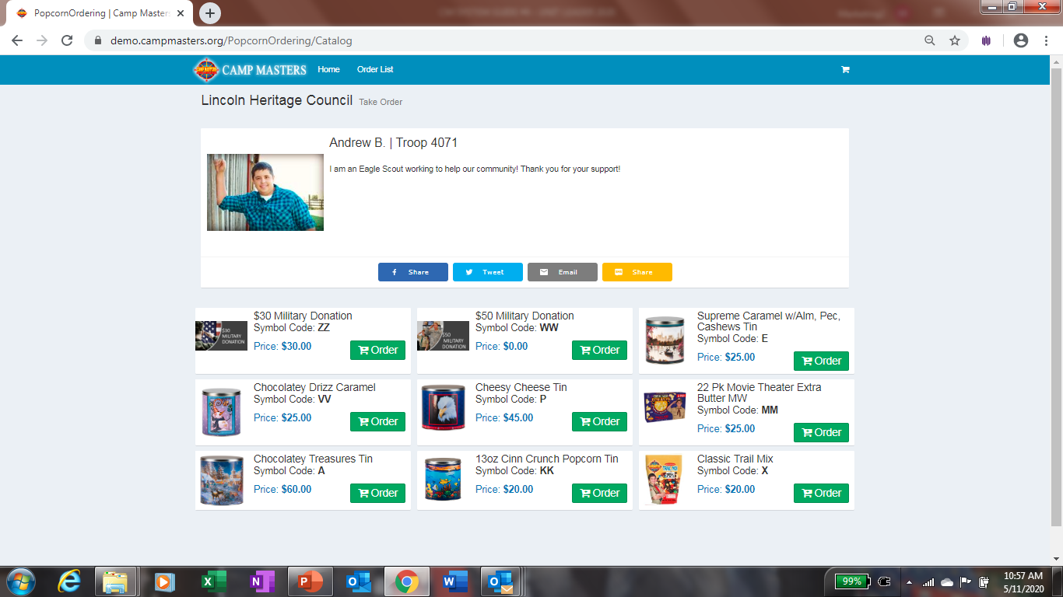
Enter the quantities for each product from the Scouts Take Order form.

Slide 17
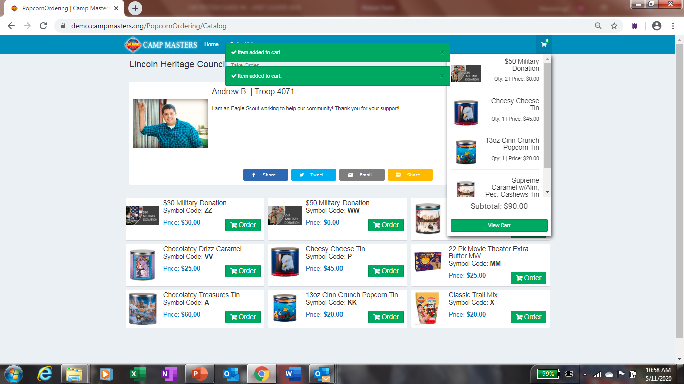
Once all quantities are entered, click on View Cart

Slide 18
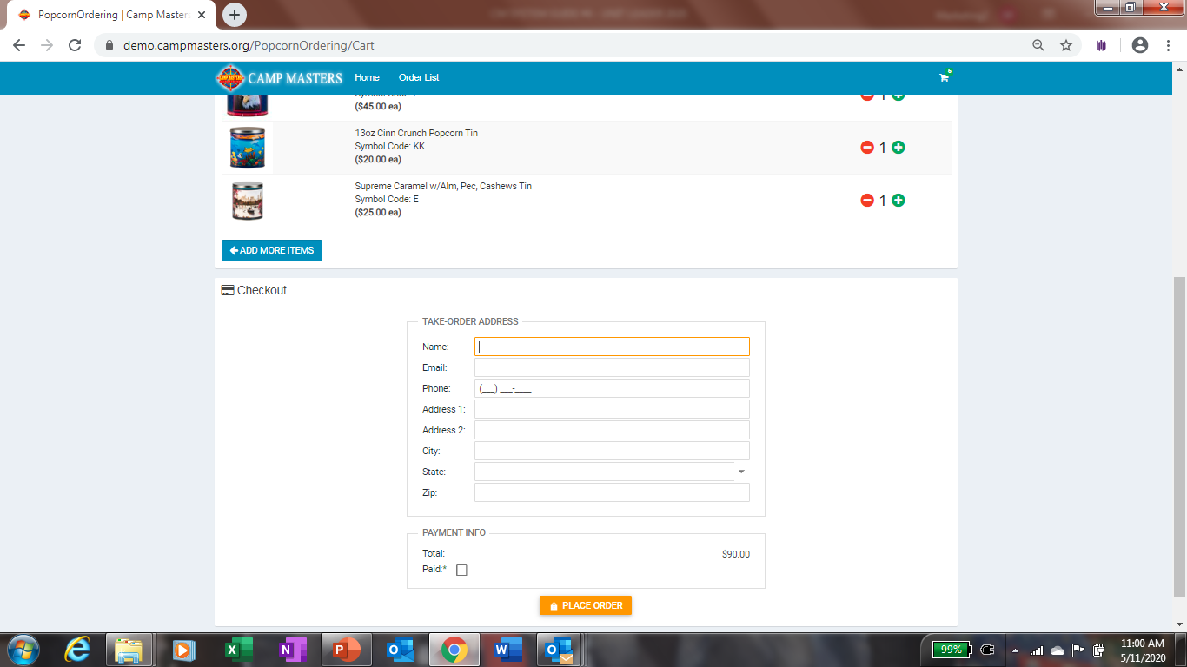
Enter Scouts information at the bottom. Then click place Order. You will do this for each Scout. When you are ready to place the Unit Take Order, your Scout quantities entered will show up in the Column “Qty Needed for Scout Sales”

Slide 19
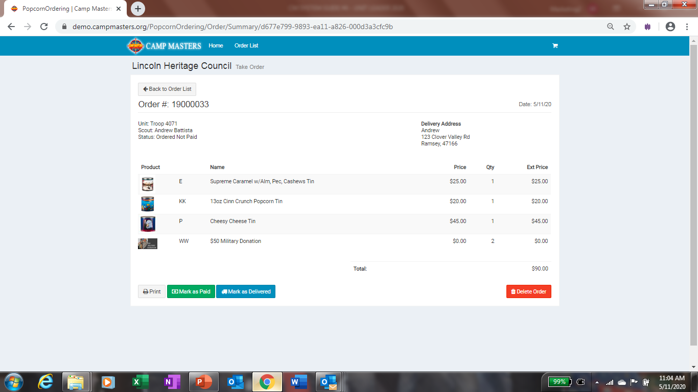
You can verify Scout Take Order is correct and print copy from here. If you need to make changes, click on “Back To Order List”

Slide 20
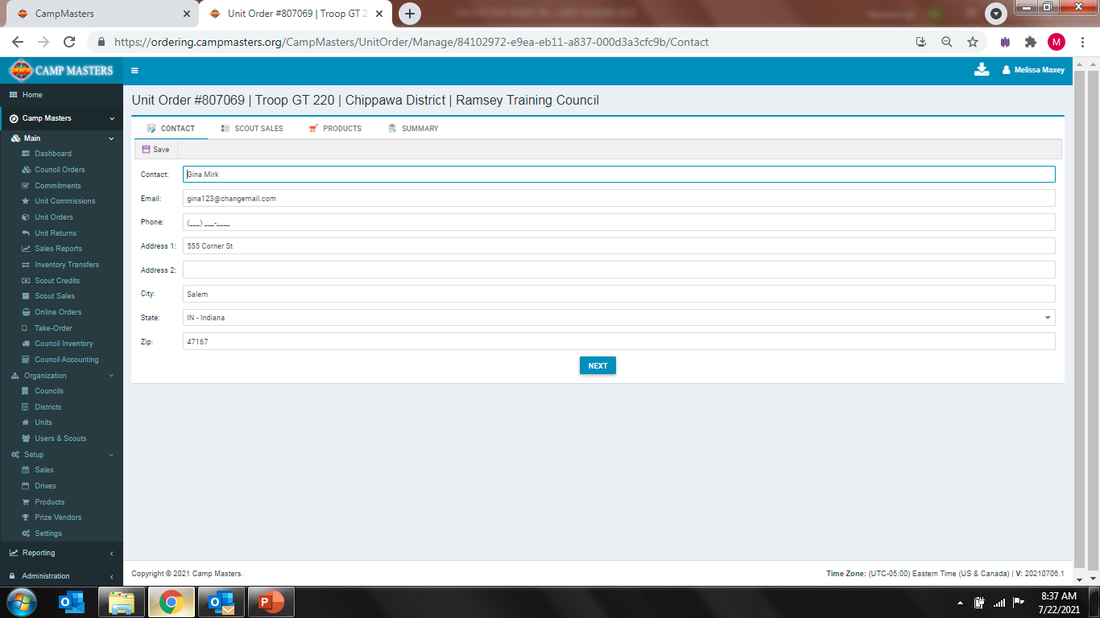
Select Next to continue placing your Order.

Slide 21
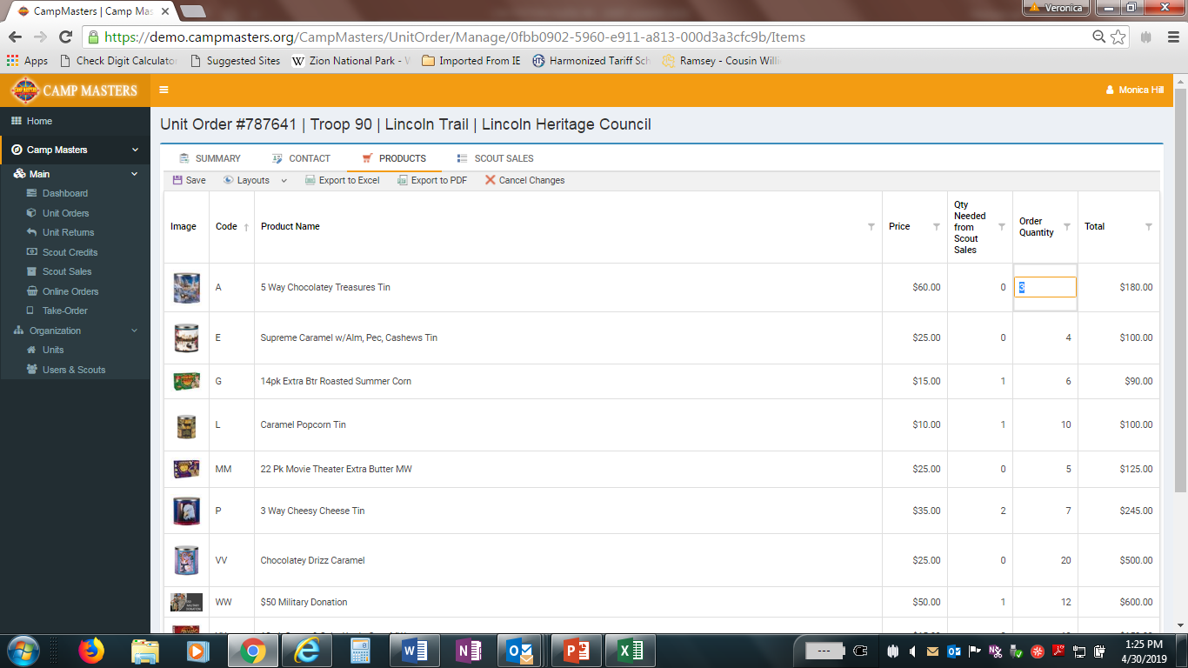
“Qty Needed from Scout Sales” (on Take Order only) will populate based on any order a Scout has submitted electronically (see “Scout Sales” top of Screen). In the “Order Quantity” column enter amount needed from Scout Sales entered digitally or by paper Take Order Form, Make Sure NOT TO DUPLICATE Scout Sales. Take Order Order Quantity can be adjusted to account for any Unit inventory/ leftover product.
After all quantities are entered & adjusted, click “SAVE”
Scout Take Order quantities will appear in “QTY NEEDED from Scout Sales”. Do not adjust this number unless Scout has an order marked as delivered. You would then decrease order quantity by that amount.

Slide 22
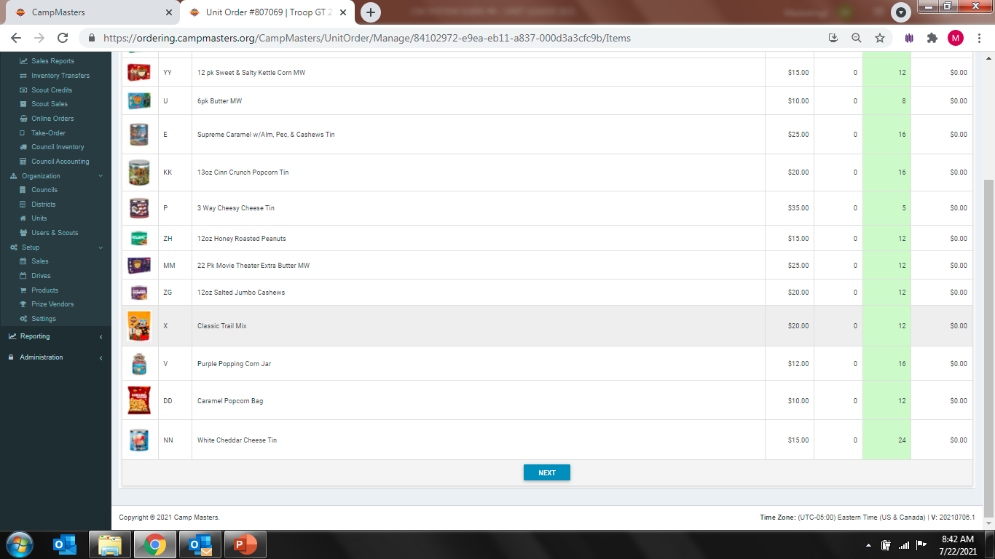
Click “Save” at the top when order is complete. Be sure to review quantities and total dollars ordered.
Once Order is complete and saved, Click Next

Slide 23
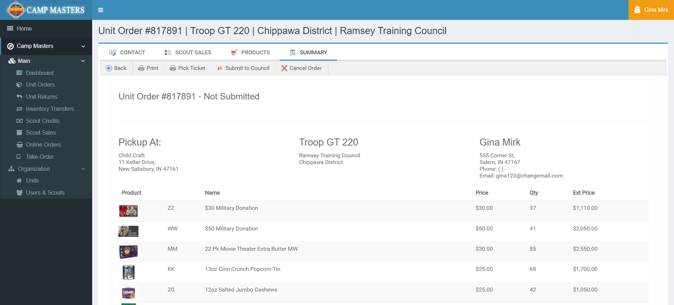
View of “SUMMARY” order.
Click “Submit to Council”
You can print a copy for your records from here.
If you need to make changes to your order once it is saved & submitted, see next page.

Slide 24

If you need to make changes to your submitted order, go back to your Dashboard and click “Unit Orders”. Screen will show all orders; click order# to be changed. This will open the order to allow changes. ANY CHANGES MUST BE MADE BEFORE “UNIT ORDER DUE” DATE to your Council

Slide 25
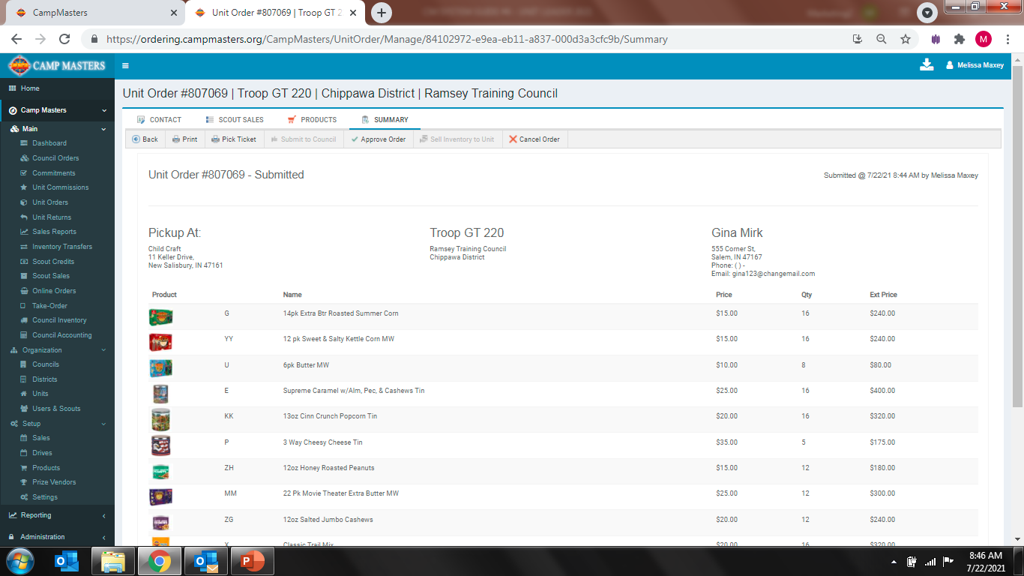
Click product to be changed. Once order is revised, click on “Save” then click on “SUMMARY”
To make changes, click on Products at the top.

Slide 26

Your Unit Order will now show as Revised. You can now get out of order

Slide 27
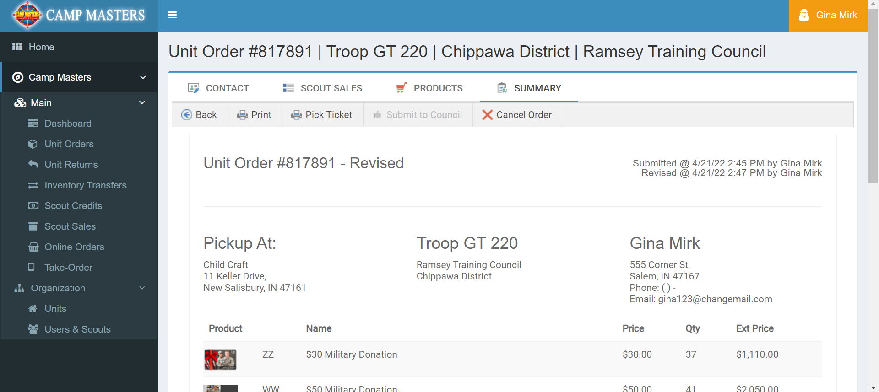
From the Summary page print your Revised Order for your records.

Slide 28
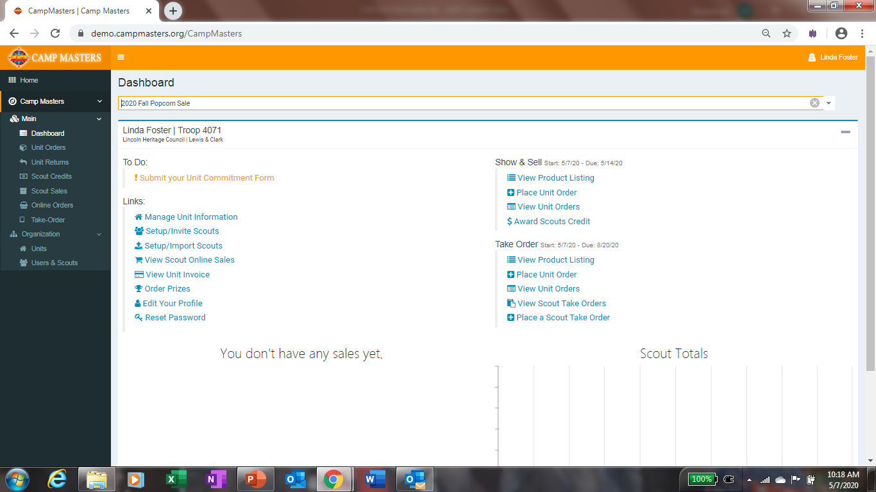
UNIT LEADER DASHBOARD/HOME PAGE BELOW.
FOR SCOUTS AND SCOUTING FAMILIES TO SELLONLINE AND ENTERING SCOUT TAKE ORDERS, REFERENCE
“CM SYSTEM GUIDE #5 – SCOUTS 2022”
BOTH GUIDES WILL BE AVAILABLE ON THE CAMP MASTERS WEBSITE – www.campmasters.org “HOW TO ORDER POPCORN”

Slide 29
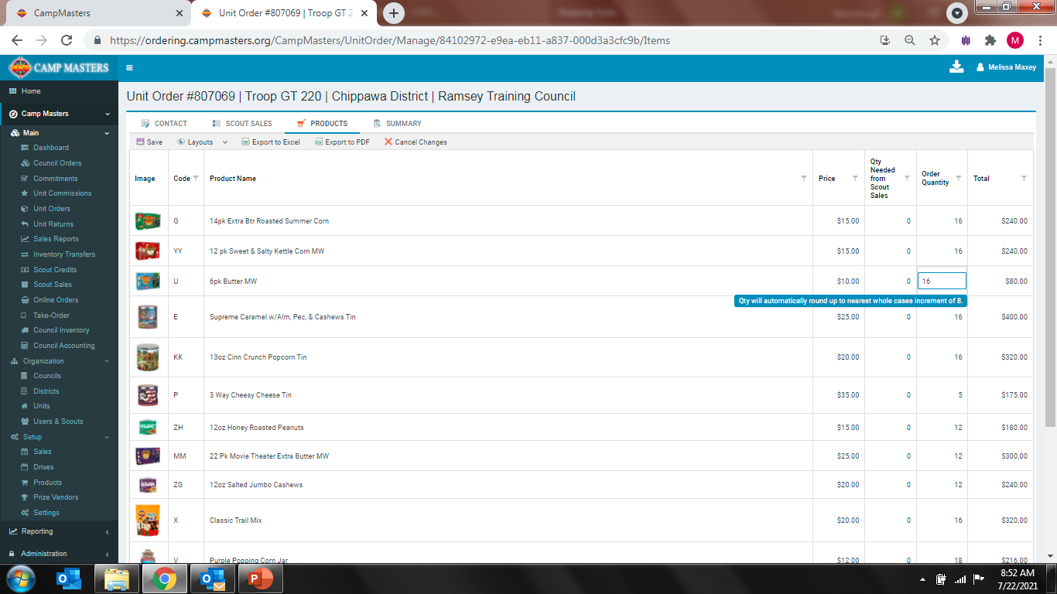
Once Order has been adjusted, Save Changes and then scroll down and click on Next at bottom of page

